Slide 1
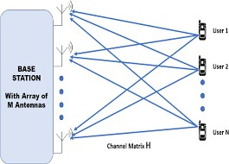
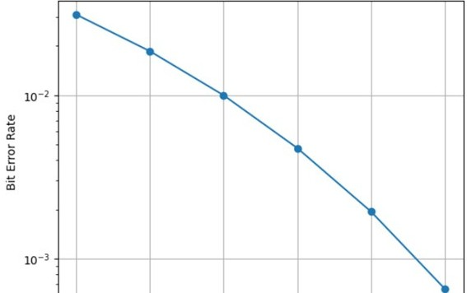
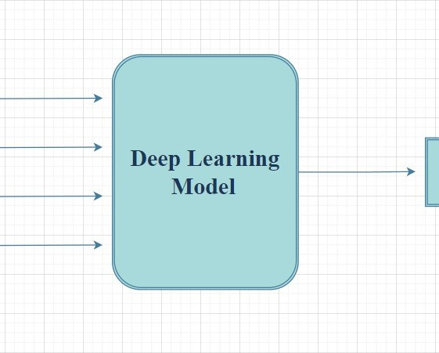
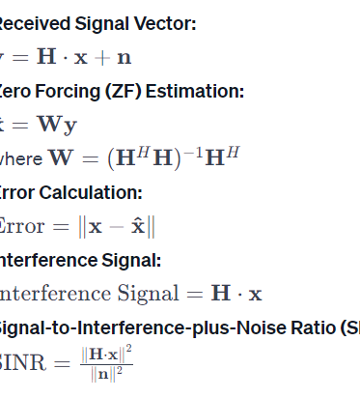
SIMULATION OF MASSIVE MIMO WIRELESS SYSTEM
Poster presentation of the course: ELC4980
Department of Electronics Engineering,
Aligarh Muslim University
<Name: ZENAB AAMIR, Faculty no. : 20ELB580 >; <Name: SANSKRITI , Faculty no. : 20ELB270>
Abstract Description and Methods
Results
The plot here shows the BER vs SNR plot of the ZERO FORCING detection technique
This project evaluates modulation
Massive-MIMO: Utilizes numerous base station antennas
Boosts spectral
efficiency and wireless capacity Enables spatial multiplexing Crucial for 5G and
beyond
Equations:
techniques detection
for Zero-Forcing (ZF) in Massive MIMO.
Results, including
Bit Error Rate
(BER) vs. Signal-to-Noise Ratio
(SNR) analysis, show ZF's optimal range and MMSE's performance at
low SNR. Comparative analysis
reveals nuanced differences,
highlighting the suitability of ZF and MMSE in varying SNR conditions for Massive MIMO
Fig 1:A Massive MIMO system with M antennas at the base station communicating with N users
Motivation
Conclusion
Our major motivation is the
Implementing Zero Forcing (ZF) detection to
significant complexity of massive
simplify computations in Massive MIMO.
Using plots to illustrate Bit Error Rate (BER)
symbol detection, this complexity
leads to the exploration of
dynamics under varying Signal-to-Noise Ratio (SNR).
suboptimal solutions, including linear
detectors and deep learning
Gaining insights into optimal SNR ranges and trade-offs between BER and SNR.
approaches, to address the challenges effectively.
Fig2. The deep learning model for massive MIMO detection
Informing parameter tuning and potential
optimizations for improved Massive MIMO
Key References
performance.
Björnson, Emil, Erik G. Larsson, and Thomas L. Marzetta. "Massive MIMO: Ten myths and one critical question." IEEE Communications Magazine 54, no. 2:114-123

